Slide 1

Alicorn Fund Research Project
Submitted by Group #3:
Birzhan Iskakov
Liuzhao Tang
Mayank Kumar Pandey
Wanwan Yang
ALY6080: Integrated Experiential Learning
Instructor: Sharad Shandilya, Ph.D.
Notes:
Add date

Slide 2

The Agenda of VC Research Project
Introduction & Background
Milestones
Objectives
Methodologies
EDA
Model Performance
Conclusions
References
Notes:
P

Slide 3

Introduction & Background
BACK
Alicorn Fund is a Venture Fund investing in pre-IPO technology startups who have reached or are poised to reach Unicorn status.
Data Resources (2015 – 2020):
All-fields dataset on VC deals in Software-DevOps companies (2184:55)
VC Backed exits (349:20)
Investor returns by Series (246:10)

Slide 4
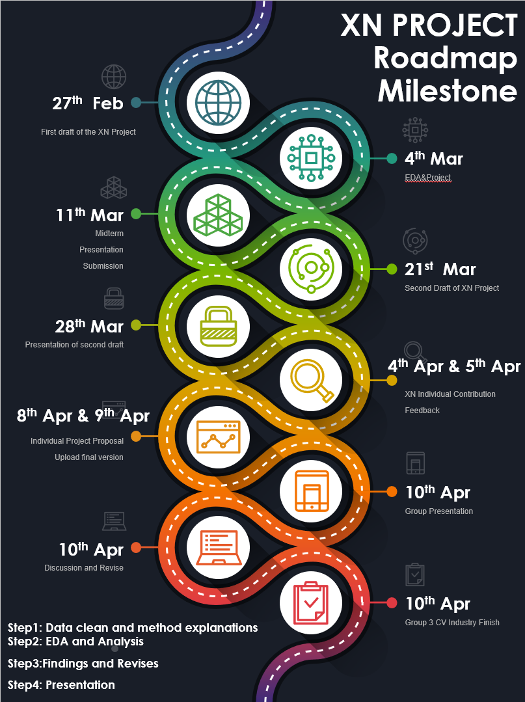
Milestones
BACK
The Roadmap distribution: 10 steps in 6 weeks
Followed by the previous 5 weeks data and industry analysis:
Step 1: Data cleansing and method explanations;
Step 2: EDA and Analysis;
Step 3: Findings and Revision;
Step 4: Presentation;

Slide 5
OBJECTIVES
BACK
Developing analytics around the Software-DevOps sector
Targeting investment company's specific characteristics
Validate the Outcomes in comparison or as complementary to the existing expert-driven due diligence and investment process.
Notes:
Validate the Outcomes in comparison or as complementary to the existing expert-driven due diligence and investment process.

Slide 6
11 Goals
Goal 1: Profiling Exits: Clustering of VC Exits.
Goal 2: The preferred shares (Preferred Capital Raised) influence investor outcomes.
Goal 3/4/6: Analysis of Return on investment (MOIC) by relevant variables.
Goal 5: Analysis of Total Preferred Capital Raised by Group and Vertical.
Goal 7/8: Build predictive models and acquisition in investor returns.
Goal 9: The Anomalies and the outliers.
Goal 10/11:Calculate as a good predictor.

Slide 7






Methodology
BACK
Model Responses | Data Pre-processing | Data Processing
9 Models and 8 Responses:
1 Clustering Model
3 Classification Models: MOIC, Acquisition Type and Exit Type
5 Regression Models: MOIC, post/exit Value, Annualized Return, and Total Preferred Capital Raised
Merge dataset if necessary
Remove all columns that contain 30%+ NAs
EDA
NAs
Replace with mean
Replace with “NA”
Outliers
Based on model performance
Validation | Model Selection | Features Engineering and Encoding
Split Ratio: 8:2(train : test)
Model metrics
Regression: MSE, MAE
Classification: Accuracy
Regression: 5 models
Classification: 3 models
3 Strategies:
Merge: “VC round”
Transform: “CompanyAge”
Remove: Company PBID
Control feature numbers

Slide 8
Boxplot of MOIC
The cleaned dataset is used for predictive models.
Outliers: The furthest point is at least 4.5 times away from the interquartile range (Q3-Q1).
BACK

Slide 9
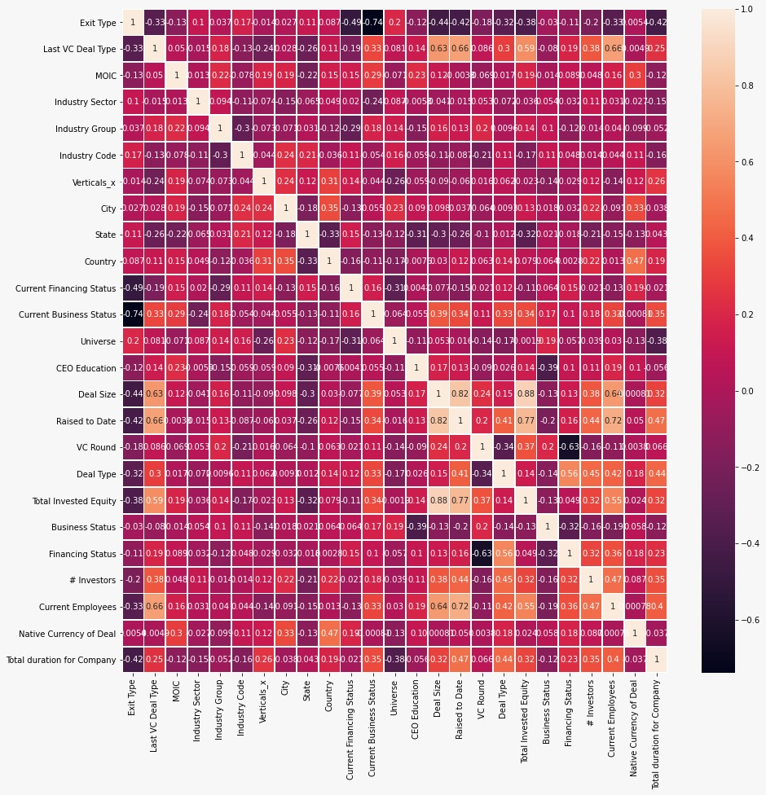
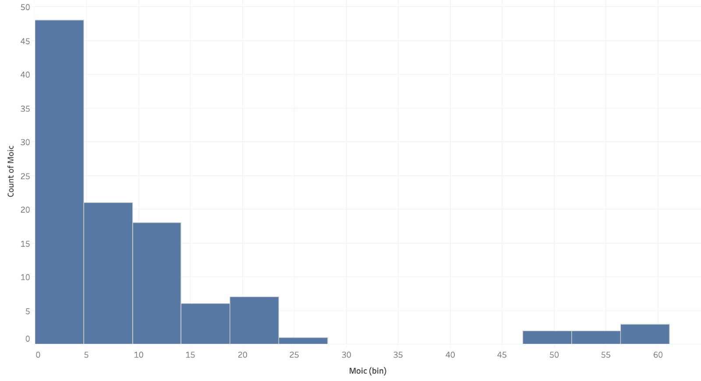
The relationship among features
No impacts: E.g. : Company PBID, Exit Date.
Distribution of Target Variable : a skewed graph towards the right
Correlation Matrix of Variables
Distribution of MOIC

Slide 10

Data Visualization
Industry Group
MOIC by Verticals
MOIC by Countries and VC Rounds
MOIC by Industrial Status
Heat Map of MOIC
Number of Employees and Company age

Slide 11
The software industry has a relatively high return on investment
Average Return of Software industry group is more than two times larger among others.

Slide 12
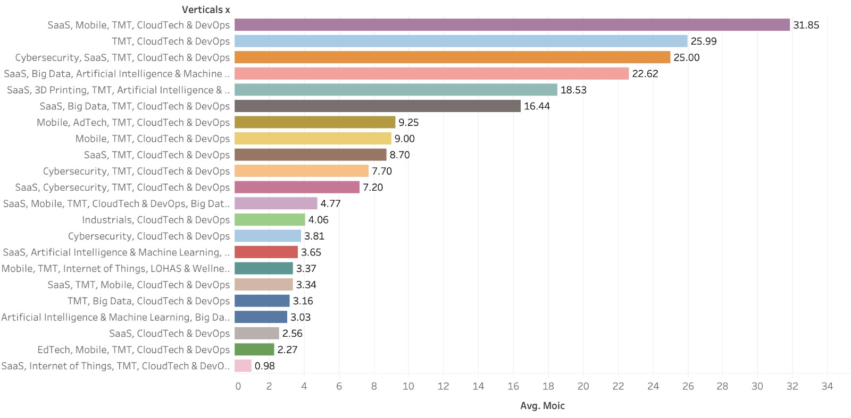
SaaS, Mobile, TMT and CloudTech & DevOps vertical leads the list with the highest Average MOIC
Notes:
Add bullet points

Slide 13
MOIC by Country and VC Round
U.S. – remained high
Initial investment: Belgium
Angel Investment

Slide 14
Average MOIC by Industrial Status
Under IT: Pending Transaction & Private Equity-backed relatively high
Formerly VC-backed: IT twice its figure than that of FC
Formerly PE-Backed relatively low

Slide 15
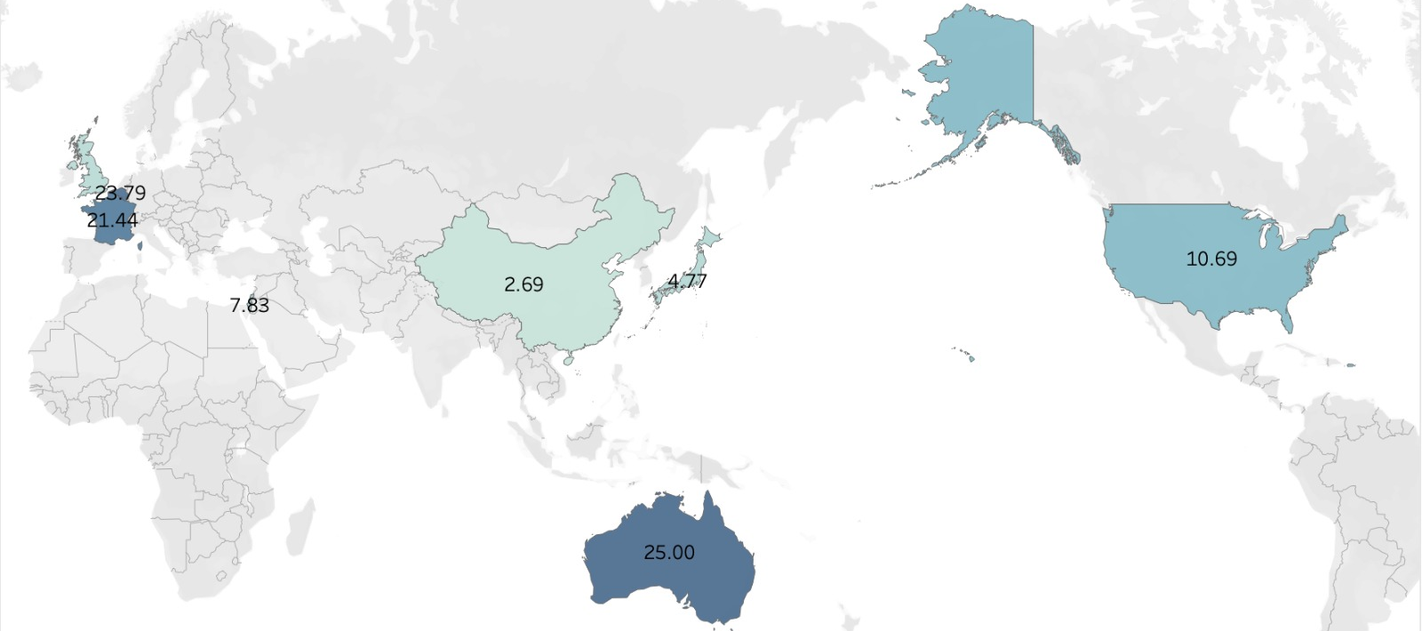
Do Australia and France really have the highest MOIC?
Notes:
Colorful map

Slide 16
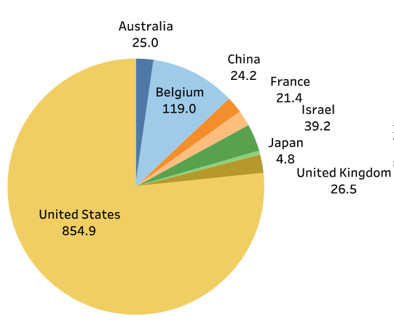
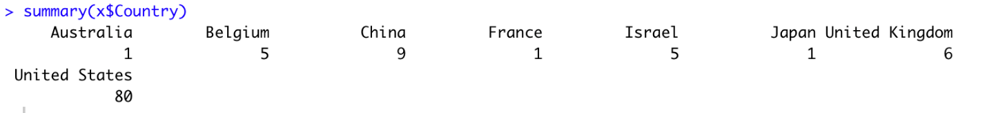
Countries with higher average MOIC has fewer companies
Pie chart represents a sum of MOIC of each country.
Australia, France and Japan have only 1 company.

Slide 17
Number of Employees and Company age have no effect on MOIC
Notes:
Change title

Slide 18
Model Performance for Regression(1/5)
BACK
Target: MOIC
Features | Importance
Current Employee | 21
Raised to Date | 14
CEO Education | 9
Last VC Deal Type | 8
Total Duration for Company | 5
VC Round | 4
Name | Train |  |  | Test
 | RMSE | MAE | RRSE(%) | RMSE | MAE | RRSE(%)
Linear Regression | 6.28 | 4.99 | 2.06 | 9.75 | 7.01 | 16.32
Ridge Regression | 6.28 | 5.01 | 2.05 | 9.84 | 7.05 | 16.36
Lasso Regression | 7.17 | 5.14 | 1.69 | 9.85 | 7.06 | 16.36
XGBOOST Regression | 2.35 | 1.57 | 0.53 | 11.61 | 5.35 | 1.88

Slide 19
Model Performance for Regression(2/5)
Target: Post Value
Features | Importance
Total Duration for the company | 9
Last VC deal type | 7
Raised to Date | 14
Total Invested Equity | 6
Current Employees | 36
Current Business Status | 5
Name | Train |  |  | Test
 | RMSE | MAE | RRSE(%) | RMSE | MAE | RRSE(%)
Linear Regression | 4639 | 2809 | 14.21 | 5468 | 2762 | 2.85
Ridge Regression | 4639.8 | 2806 | 14.22 | 5464 | 2714 | 2.86
Lasso Regression | 4639 | 2809 | 14.21 | 5464 | 2714 | 2.86
XGBOOST Regression | 514 | 204 | 0.25 | 771 | 324 | 0.67

Slide 20
Model Performance for Regression(3/5)
Target: Annualized Return
Name | Train |  |  | Test
 | RMSE | MAE | RRSE(%) | RMSE | MAE | RRSE(%)
Linear Regression | 0.61 | 0.47 | 1.93 | 0.66 | 0.52 | 149.49
Ridge Regression | 0.61 | 0.47 | 1.93 | 0.66 | 0.52 | 150.63
Lasso Regression | 0.69 | 0.46 | 14.24 | 0.36 | 0.28 | 0.48
XGBOOST regression | 0.08 | 0.05 | 0.26 | 0.24 | 0.13 | 17.01
Features | Importance
Verticals | 0.0097
City | 0.0045
Raised to date | 0.001
Current Employee | 0.00001
VC_Round | 0.00027

Slide 21
Model Performance for Regression(4/5)
Target: Exit Size
Features | Importance
Current Employees | 0.37
Total VC Capital Raised | 0.34
Company Age | 0.20
Last VC Deal Type | 0.08
Country | 0.02
Primary Industry Sector | 0.00
Name | Train |  |  | Test
 | RMSE | MAE | %ERR | RMSE | MAE | %ERR
Linear | 1595.32 | 963.58 | 39.94 | 2023.36 | 1242.19 | 54.07
Ridge | 1631.99 | 923.48 | 40.85 | 2112.28 | 1248.17 | 56.44
XGB | 350.34 | 156.17 | 8.77 | 1006.22 | 424.17 | 26.89
Lasso | 1595.36 | 964.24 | 39.94 | 2023.04 | 1241.01 | 54.06
ElasticNet | 1595.51 | 961.02 | 39.94 | 2028.03 | 1242.23 | 54.19
RandomForest | 357.76 | 159.80 | 8.96 | 620.61 | 308.87 | 16.58

Slide 22
Model Performance for Regression(5/5)
Target: Total Preferred Capital Raised
Features | Importance
Current Employees | 0.45
Raised to Date | 0.33
Last VC Deal Type | 0.12
Company Age | 0.09
Country | 0.02
Primary Industry Group | 0.00
Primary Industry Sector | 0.00
Name | Train |  |  | Test
 | RMSE | MAE | %ERR | RMSE | MAE | %ERR
Linear | 165.84 | 72.20 | 51.28 | 172.15 | 72.75 | 70.40
Ridge | 168.38 | 65.16 | 52.06 | 176.97 | 65.53 | 72.37
XGB | 59.38 | 26.88 | 18.36 | 117.14 | 50.48 | 47.90
Lasso | 165.84 | 72.12 | 51.28 | 172.15 | 72.48 | 70.40
ElasticNet | 165.85 | 71.87 | 51.28 | 172.20 | 72.21 | 70.42
RandomForest | 39.71 | 15.10 | 12.28 | 84.19 | 33.98 | 34.43

Slide 23
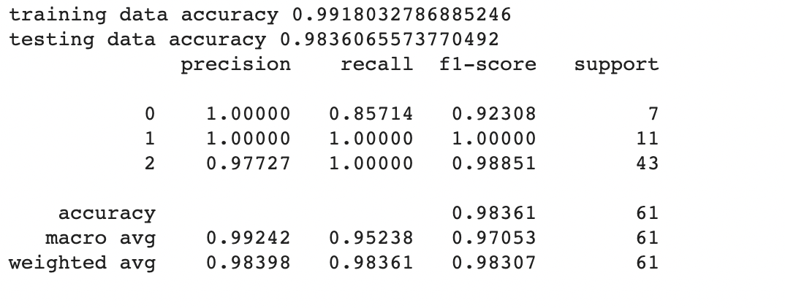
Model Performance for Classification(1/3)
Target: Exit Type

Slide 24
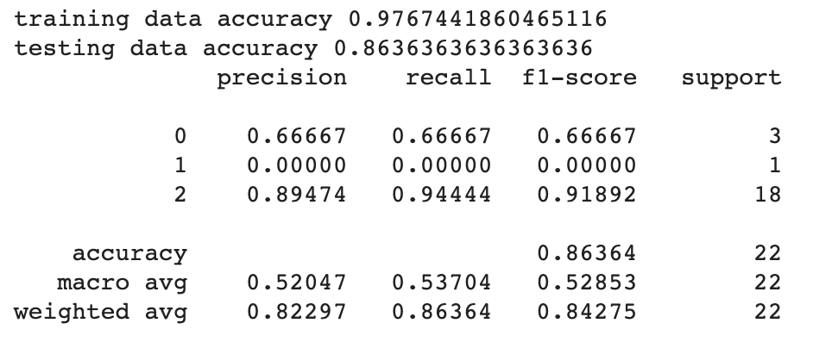
Model Performance for Classification(2/3)
Target: MOIC
Features | Importance
Last VC Deal Type | 0.17
City | 0.13
Industry Code | 0.09
Industry Group | 0.09
Country | 0.08
Raised to Date | 0.07
Total Duration | 0.06

Slide 25
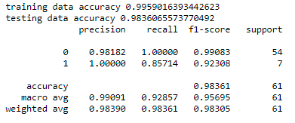
Model Performance for Classification(3/3)
BACK
Features | Importance
Current Financing Status | 0.32
Universe | 0.19
Industry Code | 0.12
City | 0.09
Total duration for Company | 0.04
Verticals | 0.04
Last VC Deal Type | 0.04
Current Business Status | 0.04
Deal Type | 0.03
Country | 0.02
Native Currency of Deal | 0.02
Business Status | 0.02
Industry Group | 0.00
Industry Sector | 0.00
Target: Acquisition Type
1: Total Acquisition (Exit Type = “Buyout”)
0: Partial Acquisition (all other exit types)

Slide 26
Conclusions
BACK
1. The companies with higher MOIC would have these features below:
Software Industry Group;
SaaS, Mobile, TMT and CloudTech & DevOps Vertical;
Initial investment: The U.S. and Belgium;
Under IT Industry: Pending Transaction & Private Equity-backed;
Representation of the investment return does not always depend on countries;
Number of Employees and Company age have NO EFFECT on MOIC;
2. There were 9 models created and 8 responses received.
Regression: 5 models
Classification: 3 models
Classification model is giving better result than regression and hence
we can conclude that with more data point model prediction will improve.

Slide 27
References
BACK
Arowanaco.com, (2021). Businesses. Alicorn. Retrieved from: https://arowanaco.com/operating-companies/alicorn/
Box plot: Display of distribution. (n.d.). Retrieved from http://www.physics.csbsju.edu/stats/box2.html
Roadmap basics: What is a roadmap? (2021). Retrieved from https://www.productplan.com/learn/roadmap-basics/
Venture-capital-backed IPO - overview, funding, debt financing. (n.d.). Retrieved from https://corporatefinanceinstitute.com/resources/knowledge/trading-investing/venture-capital-backed-ipo/#:~:text=A%20venture%2Dcapital%2Dbacked%20IPO%20is%20the%20initial%20offering%20of,of%20initial%20public%20offering%20(IPO)
Violin plots 101: Visualizing distribution and probability density. (n.d.). Retrieved from https://mode.com/blog/violin-plot-examples/
What are mean squared error and root mean Squared error? (2001). Retrieved from https://www.vernier.com/til/1014

Slide 28
Thank you !

